Slide 1

A DEEP LEARNING-BASED DRIVER MONITORING SYSTEM FOR FATIGUE, DISTRACTION, AND EMOTION DETECTION
submitted_by:Dhilip Kumar Reddy Tikkam
Student_id:811360997
Course:ADVANCED MACHINE LEARNING (BA-64061-001)

Slide 2
ABSTRACT:
Developed a non-invasive Deep Learning–based Driver Monitoring System using a standard RGB webcam.
Detects drowsiness, distraction, and emotional distress simultaneously.
Uses YOLOv8, Dlib, and DeepFace for real-time monitoring.
Designed in alignment with EU General Safety Regulations (GSR).

Slide 3
INTRODUCTION:
Automotive safety is shifting from passive measures (airbags, crumple zones) to active accident prevention.
Traditional systems monitor vehicle kinematics but ignore the driver’s physiological and psychological state.
Drivers face a “trinity of risk”: fatigue, distraction, and emotions affecting decision-making.
A computer vision–based system can proactively assess the driver, turning the vehicle into an active safety partner.
In the future there will be a way to automate responses based on
pre-written keywords and through machine learning.
Presentations are communication tools that can be used as demonstrations, lectures, speeches, reports, and more. It is mostly presented before an audience.
Proliferation of Chat Bots

Slide 4
The Reality of Road Safety:
Traffic accidents cause 1.19 million deaths yearly, mostly due to human error.
EU mandates DDAW (2024) and ADDW (2026) with direct camera monitoring.
Euro NCAP penalizes vehicles without driver monitoring or “Owl-type” detection.
Supports Vision Zero by using tech to reduce fatalities.
In the future there will be a way to automate responses based on
pre-written keywords and through machine learning.
Presentations are communication tools that can be used as demonstrations, lectures, speeches, reports, and more. It is mostly presented before an audience.
Proliferation of Chat Bots

Slide 5
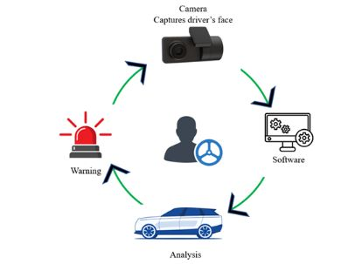
System Architecture:
Captures live driver video at 30 FPS using a webcam.
Processes video via three parallel paths: YOLOv8 (object detection), Dlib (facial landmarks), and DeepFace (micro-expression analysis).
Aggregates outputs into a composite “Safety Score” to assess driver condition.
Triggers audio-visual alerts and runs on a Python backend with OpenCV.

Slide 6
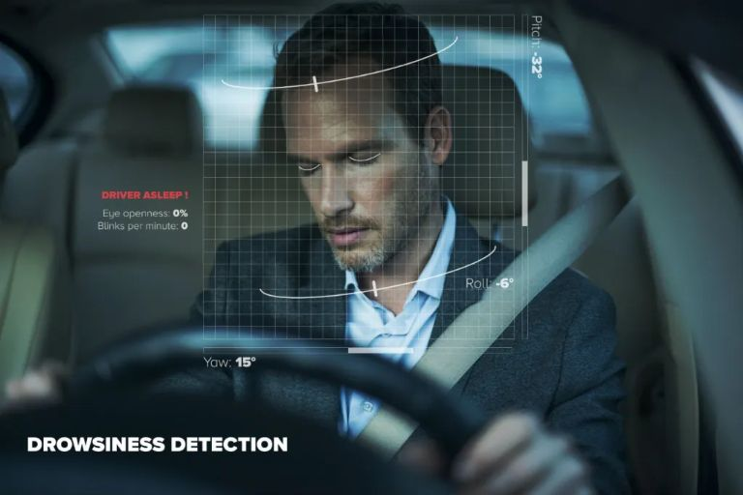
Methodology I: Distraction Detection
Uses YOLOv8 for real-time, single-shot distraction detection.
Anchor-free design predicts object centers, reducing computation.
Fine-tuned on a custom driver dataset to detect Phone_Left, Phone_Right, Yawning, and Active states.
Instantly detects fleeting distractions, even with partial occlusion, at millisecond speed.

Slide 7
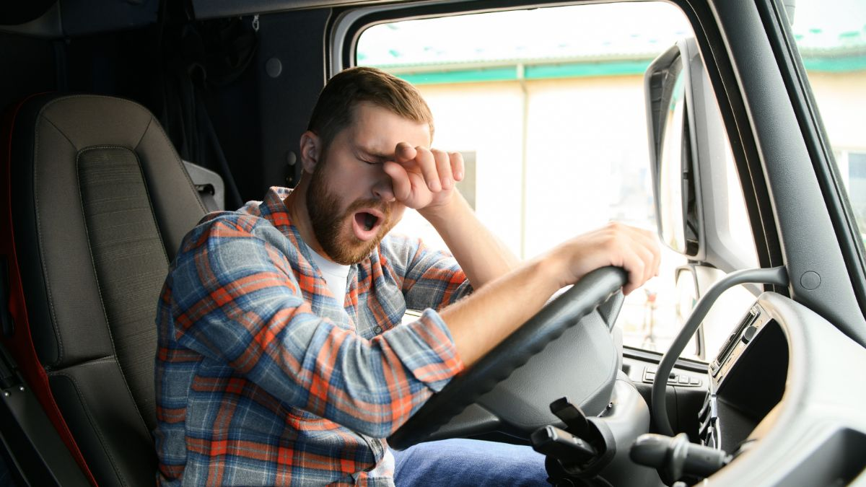
Methodology II: Drowsiness
Uses 68-point facial landmark detection to monitor eye geometry.
Calculates Eye Aspect Ratio (EAR) to detect eyelid closure.
EAR below threshold for ~1 second triggers a microsleep alert.
Geometric approach is computationally efficient and robust to head rotation.

Slide 8
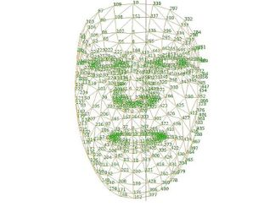
Methodology III: Emotion Recognition
Uses DeepFace CNN for emotion recognition.
Pipeline: Detect face → Align eyes → Extract deep features.
Recognizes five classes: Angry, Happy, Sad, Neutral, Fear.
Differentiates high-arousal (Anger) vs. low-arousal (Fatigue/Sadness) to guide interventions

Slide 9
Uses FER2013 and a custom annotated driver dataset, addressing class imbalance issues.
Applies augmentations like rotation, shear, and zoom to simulate real driving conditions.
Enhances model robustness against vibrations and varying camera angles.
Visual support includes the data distribution histogram from the report.
Data Strategy & Augmentation:

Slide 10
Delivers strong performance across phone detection, drowsiness detection, and emotion recognition.
Training shows smooth and consistent loss convergence.
Validation accuracy closely aligns with training accuracy, indicating minimal overfitting.
Includes visual graphs for YOLO training loss and emotion accuracy trends.
Quantitative Results:

Slide 11
Emotion model struggles to separate subtle classes like Sad vs. Neutral, while Anger and Happiness are identified more reliably.
Performance drops in low-light conditions since RGB cameras cannot handle complete darkness.
Occlusions such as sunglasses block eye landmarks, causing failures in drowsiness detection.
Confusion between certain emotions is expected due to overlapping facial features and subtle expressions.
Critical Analysis & Limitations

Slide 12
Research is shifting from CNNs to Vision Transformers, which capture global context and temporal patterns more effectively.
Attention-enhanced models like ME-YOLOv8 focus on the driver’s face while ignoring irrelevant background regions.
Generative AI is increasingly used to create synthetic drowsy datasets to address class imbalance.
While CNNs remain efficient for real-time use, future advancements point toward Transformer-based video understanding.
Current Research Landscape

Slide 13
Sensor fusion with RGB, NIR, and radar can overcome issues like sunglasses and night-driving failures.
Edge AI enables on-device processing for low latency and improved privacy compliance.
Future systems evolve toward “Empathic Cars” that actively intervene based on driver state.
Moves from simple monitoring to real-time safety actions for enhanced protection.
Future Evolution:

Slide 14
Integrates three complementary methods: YOLO, Dlib, and DeepFace.
Delivers real-time performance on standard, low-cost hardware.
Demonstrates that computer vision offers a strong non-invasive approach to driver safety.
Aligns with the technical requirements of upcoming EU driver monitoring mandates.
Conclusion:

Slide 15
THANK YOU

